Slide 1
Positionality & Practice, A.R.P , Presentation
Nick Dunn

Slide 2
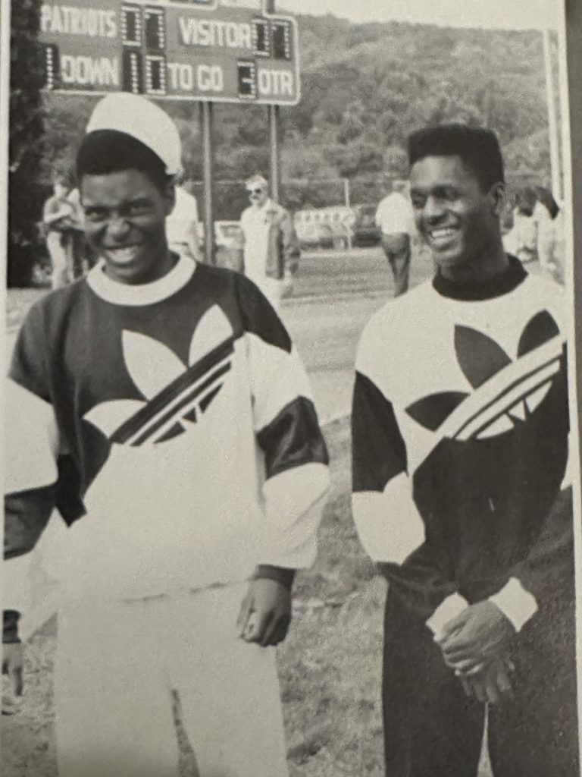
My A.R.P, Research Question.
What can we as academics do to give more exposure to the inclusive practices we undertake, in order to enrich our current students’ experiences, promote and encourage the next generation to see HE creative education as a valid option?

Slide 3
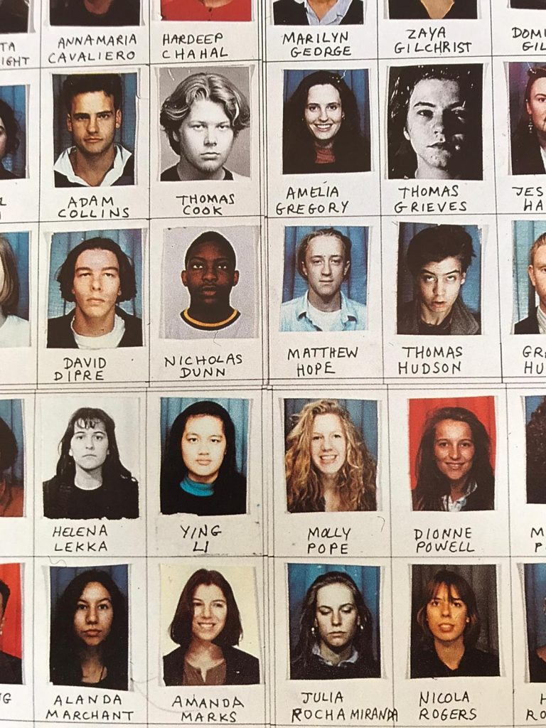
Barriers
Out of a graduating cohort of 220 students on my Foundation course at Camberwell in 1992 only 8 students were black.
Imposter Syndrome

Slide 4
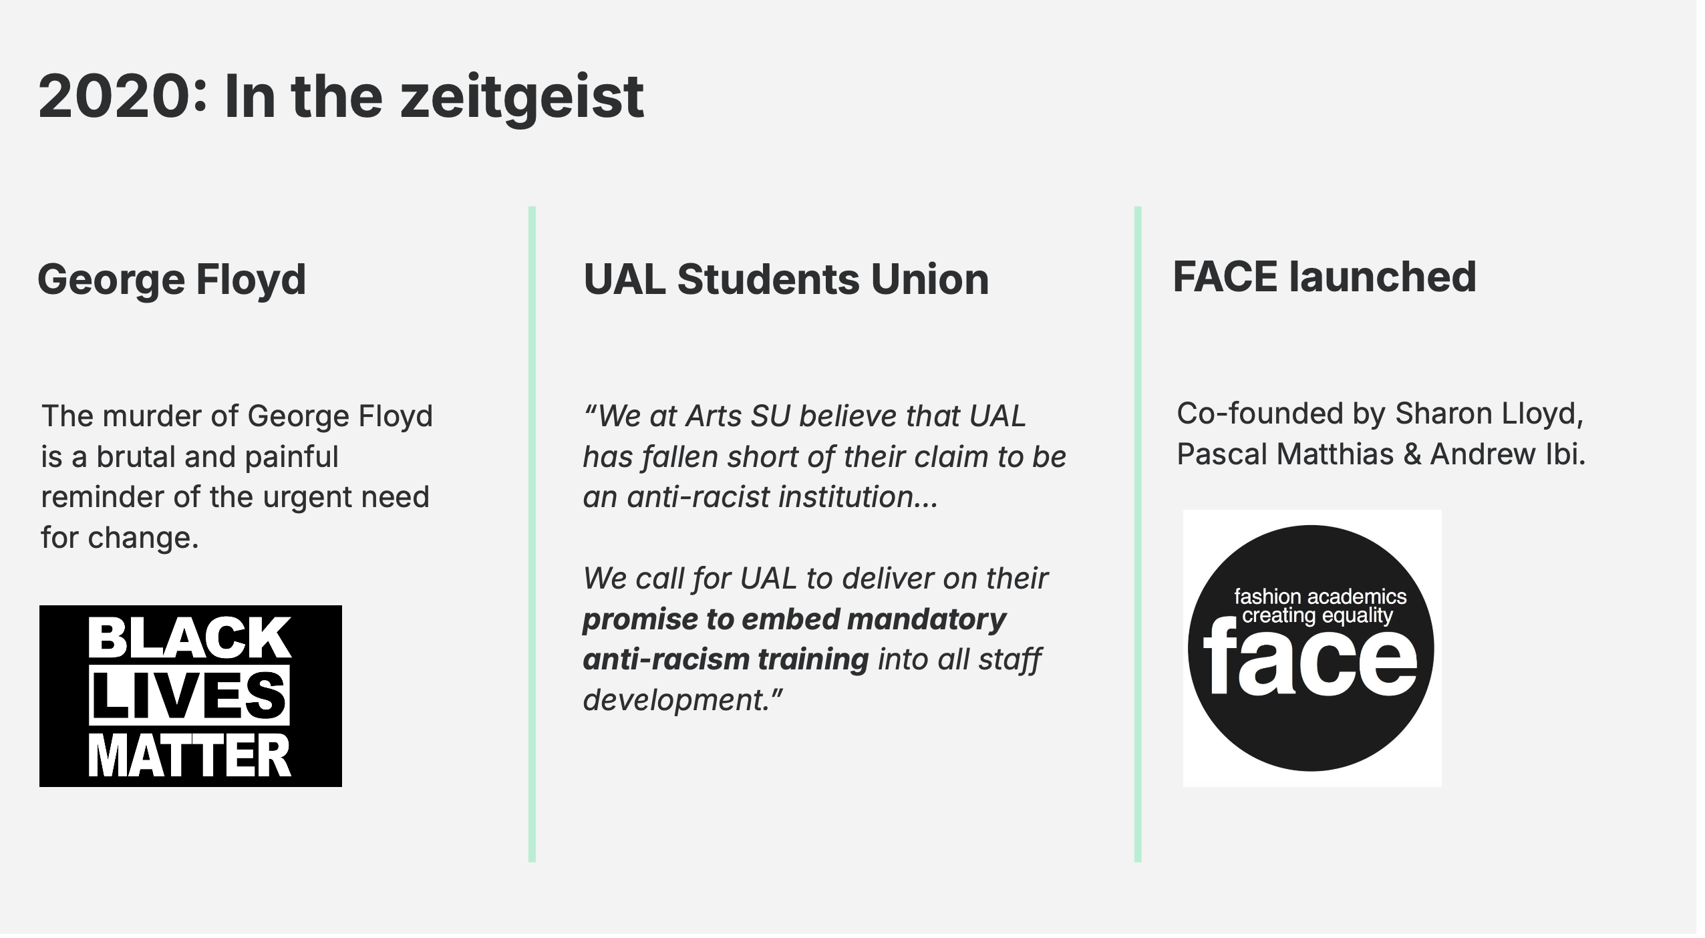

Slide 5
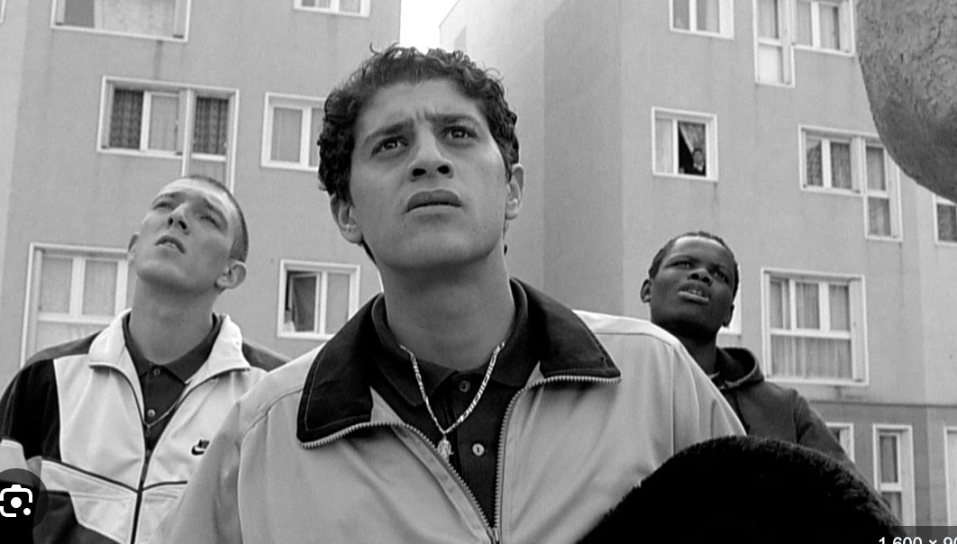
Activity: Positionality & Practice, Workshop, BATDY3
- A 3 hour workshop with BATDY3 students, Jodie Ruffle (BATDY3 leader) and Nick Dunn
- Short presentation (45mins) from Nick & Jodie about our own historical positionality when we were undergraduates, and in hindsight how these identities reflected in our work / career trajectory.
- Informal Group Discussion focused on Positionality & Practice (120mins)

Slide 6


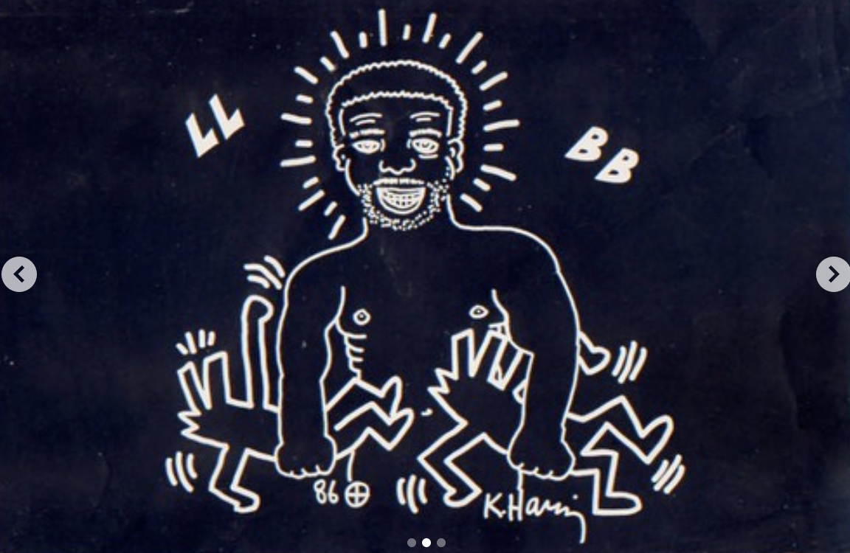
We asked the students to think of work that they felt aligns with how they perceived their identity through the following mediums to aid our group discussion.
- Piece of music or musical genre or a particular musician.
- A film/genre or a particular director/ cinematographer.
- A book/genre or a particular author.
- Textile, artist, practitioner, fashion designer, label, brand.
- An environment, neighbourhood, place or community.

Slide 7
The key characteristics or learning outcomes desired were as follows.
– Practice being self-aware, reflecting on the world around us, our own biases and positionality.
– Recognizing and responding to the differences and synergies of positionality stand points within the room.
– Start to entertain the notion of positionality being utilized and referenced in practice.
The workshop took a decentred approach by:
– Acknowledge multiple ways of knowing, and the value of difference
– Non hierarchical approach – students and staff were both learners and educators
– Students voices were central to the discussion and direction of the discussion.

Slide 8
Data Capture; Questionnaire
For my questionnaire I adapted the work of Dr. Stephen Brookfield’s Critical Incident Questionnaire (C.I.Q)
I used five CIQ questions with a sixth additional in reference to the sessions relativity to their ongoing unit work. The questions asked were as follows.
At what moment in today’s session did you feel most engaged with what was happening?
At what moment in today’s session were you most distanced from what was happening?
What action that anyone (teacher or student) took today did you find most affirming or helpful?
What action that anyone took today did you find most puzzling or confusing?
What about the class today surprised you the most? (This could be about your own reactions to what went on, something that someone did, or anything else that occurs).
Do you think making space for sessions like this would be beneficial for your ongoing work ? If your answers yes, why ?

Slide 9
Student Feedback
Q1- At what moment in today’s session did you feel most engaged with what was happening?
50% answered; 45min Positioning Presentation
50% answered; Group Discussion.
‘When there was group discussion, back and forth, in the best possible way, the initial exercise question gets lost!’
BATDY3 Student comment
Q2- At what moment in class this was you most distanced from what was happening?
80% answered; Never felt distant through the whole session.
20% answered; In the group discussion, feeling self conscious about verbally contributing to the discussion.
‘I felt distant at the start of the group discussion because i was in my head about being vulnerable and sharing about myself.’
BATDY3 Student comment

Slide 10
Student Feedback
Q3- What action that anyone (teacher or student) took in this session did you find most affirming or helpful?
40% answered; The tutors transparency in their positionality presentations.
60% answered; Their (students) personal self-realization within the informal group discussion.
‘When Luna shared her experience of her ethnic influence she was vulnerable, and this inspired me to share in the discussion too. Also Nick saying you need to not care what people think in terms of sharing your thoughts’.
BATDY3 Student comment

Slide 11

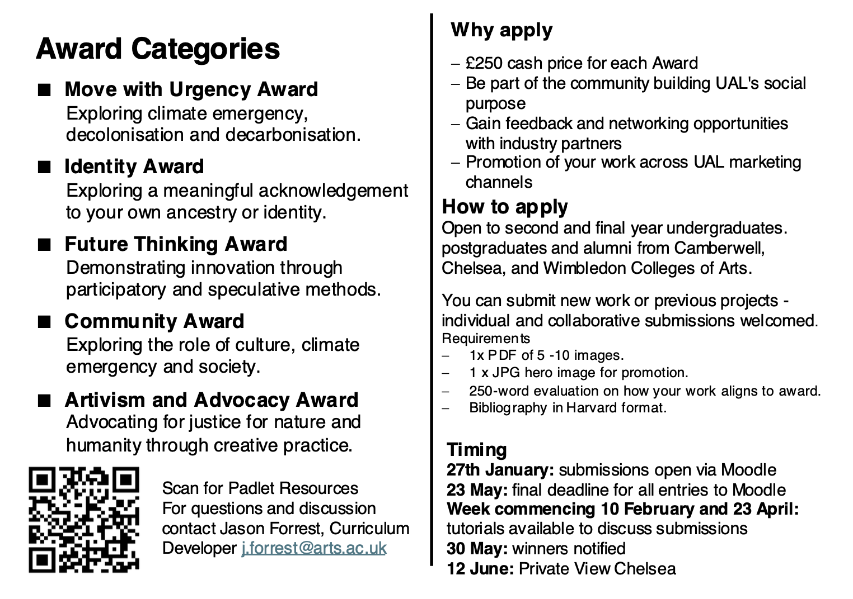
Next Steps, Going Forward..
Next steps, Goin

Slide 12
Bibliography
@rootsandroutes.ual
https://www.weareface.uk/
Audre Lorde, Sister Outsider, Crossing Press, 1984
https://static1.squarespace.com/static/5738a0ccd51cd47f81977fe8/t/5750e567f699bbceac6e97f5/1464919400130/CIQ.pdf
https://www.stephenbrookfield.com/critical-incident-questionnaire
AI generated definition based on: Energy Research & Social Science, 2023
Hooks 1994, p,110, Teaching in Trangress: Education as the Practice of Freedom.
Participatory data gathering and co-analysing data with participants using thematic analysis‘ >53 minute video

